Slide 1
Micro-Credit Defaulter Project
By
SWATHI R

Slide 2
ACKNOWLEDGMENT
The internship opportunity I had with Flip Robo was a great chance for learning and professional development. Therefore, I consider myself as a very lucky individual as I was provided with an opportunity to be a part of it.
I would like to thank our SME for suggesting this project and for his whole hearted cooperation and constant encouragement throughout the project.
And I also like to thank the data trained mentors and Technical team members for helping me with the technical queries.
And these are the following website which I referred for the reference
https://www.kaggle.com/
https://scikit-learn.org/
www.stackoverflow.com
www.google.com
www.geeksforgeeks.org

Slide 3
Business Problem Framing
A Microfinance Institution (MFI) is an organization that offers financial services to low income populations.
MFS becomes very useful when targeting especially the unbanked poor families living in remote areas with not much sources of income. They are collaborating with an MFI to provide micro-credit on mobile balances to be paid back in 5 days.
We need to Build a model which can be used to predict in terms of a probability for each loan transaction, whether the customer will be paying back the loaned amount within 5 days of insurance of loan

Slide 4
With the help of Pandas Library We will upload our data to Jupyter Notebook.
Once our data is uploaded with the help of predefined method (i.e. read_csv) we can read data for further processing.
We have two type of variables in the data:-
Dependent Variable
Independent Variable

Slide 5
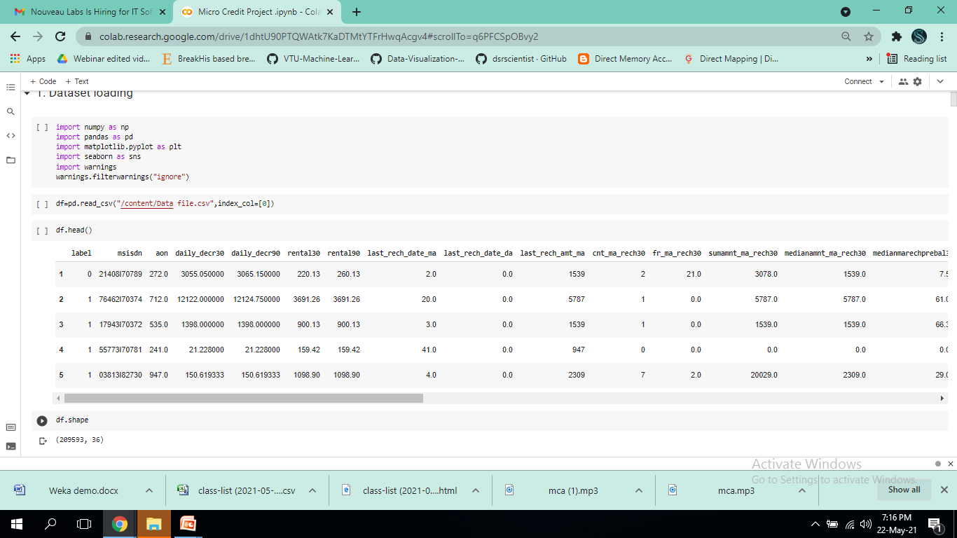
Data file

Slide 6
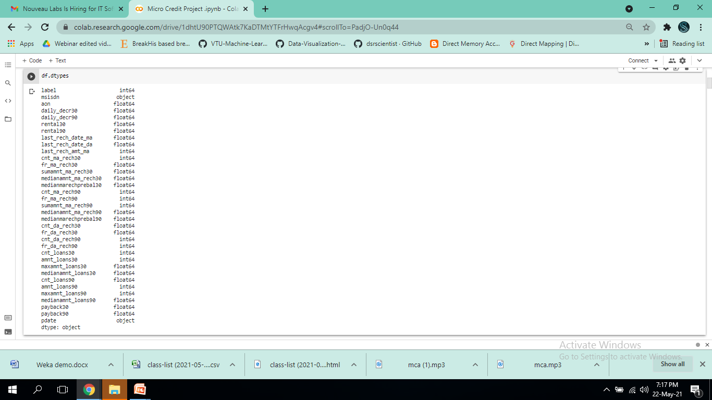
Label is an independent variable where as all of the other element are dependent variable.

Slide 7
Analytical Modeling of the Problem
After uploading the data I get to know the data by the data.describe() so many information the min value , max value, SD the 25 percentile the 50th percentile the 75 percentile of the data.
Then by the help of .skew() I get to know the skewness of the data. Then by the help of correlation function I get to know the correlation of each columns with each other.
From the heatmap I can visualized to see them clearly that they are positive correlated or the negative correlated the dark side is show the negative correlation among each other the lighter side represent the positive correlation among the each other.

Slide 8
MODELS USED
Classification Model with following algorithms
KneighborsClassifier
LogisticRegression
DecisionTreeClassifier
GaussianNB
SVC
Evaluation metrics
Accuracy score
Precison, recall
AUC,ROC
F1 score

Slide 9
Key Metrics for success in solving problem under consideration
Precision: can be seen as a measure of quality, higher precision means that an algorithm returns more relevant results than irrelevant ones
Recall is used as a measure of quantity and high recall means that an algorithm returns most of the relevant results.
Accuracy score is used when the True Positives and True negatives are more important. Accuracy can be used when the class distribution is similar
F1-score is used when the False Negatives and False Positives are crucial. While F1-score is a better metric when there are imbalanced classes.
Cross_val_score :- To run cross-validation on multiple metrics and also to return train scores, fit times and score times. Get predictions from each split of cross-validation for diagnostic purposes. Make a scorer from a performance metric or loss function.
roc _auc _score :- ROC curve. It is a plot of the false positive rate (x-axis) versus the true positive rate (y-axis) for a number of different candidate threshold values between 0.0 and 1.0

Slide 10
RESULT
Totally 5 models are performed
KneighborsClassifier
LogisticRegression
DecisionTreeClassifier
GaussianNB
SVC
Among that 3 models have been chosen and performed hyper parameter tuning.
Then those 3 models are evaluated using the evaluation metrics and the best model is chosen.
The best model is Random Forest with
Accuracy: 0.909783
Precision: 0.913267
Recall: 0.991406
F1 score: 0.950734

Slide 11
Conclusion
I check the data first and uploaded the data in jupyter notebook and than I visualize the features ,Perform the preprocessing in the data and understand the relationship between different features.
I used both train-validation split and the cross validation to evaluate the model effectiveness to predict the target values.
At the end I applied the 5 predictive models in the data.
Then after performing all the model the best model is chosen as Random Forest with accuracy of 0.9030

Slide 12
THANK YOU

